Slide 1

mdchamber.org/competitiveness

Slide 2

The Maryland Chamber
& Our Mission
The mission of the Maryland Chamber of Commerce is to advance inclusive partnerships for a Maryland where all businesses and their communities thrive.
We believe business makes Maryland better; we need to make Maryland better for business.

Slide 3
Understanding Where We Rank
Business Friendliness
Population Trends
Tax Environment
Business & Job Growth
Transportation & Infrastructure
Energy Costs
GDP Data

Slide 4
Business Friendliness Trends

Slide 5
2024 Business Friendliness Trends: Key Drivers of Economic Growth
Why it Matters:
Business friendliness, the cost of doing business, infrastructure, workforce quality, and overall economic health are critical factors that businesses evaluate when deciding where to establish and expand.
Understanding these trends helps states and regions create environments that attract investment, drive growth, and build a thriving business community.
Data Sources: CNBC's Top States For Business Survey

Slide 6

CNBC’s Top States: 2024
MD 31st
47th cost of
doing business
37th business friendliness
37th for infrastructure
Metric | MD ‘22 | MD ‘23 | MD ‘24 | VA ‘24 | PA ‘24 | DE ‘24
Overall | 27th | 22nd | 31st overall ↓ | 1st overall | 17th overall | 34th overall
Business Friendliness | 29th | 24th | 37th ↓ | 5th | 41st | 46th
Infrastructure | 22nd | 15th | 37th ↓ | 3rd | 20th | 23rd
Workforce | 10th | 28th | 28th -- | 9th | 35th | 7th
Cost of Doing Business | 44th | 47th | 47th -- | 24th | 27th | 44th
Economy | 31st | 31st | 30th ↑ | 11th | 34th | 10th
Quality of Life | 18th | 11th | 16th ↓ | 19th | 25th | 27th
Tech & Innovation | 14th | 7th | 8th ↓ | 15th | 7th | 35th
Education | 18th | 21st | 14th ↑ | 1st | 3rd | 45th
Cost of Living | 44th | 27th | 24th ↑ | 19th | 7th | 14th
Access to Capital | 13th | 13th ╍ | 16th ↓ | 8th | 5th | 26th
CNBC’s Top States for Business, July 2024
Notes:
Maryland’s decline this past year is not out of the ordinary – the trends over the last three years show declines for:
Overall ranking
Business friendliness
Infrastructure
Quality of Life
Tech & Innovation
Access to Capital
And several areas of stagnation – Workforce; Cost of Doing Business
While our neighboring states have been improving over this same time period

Slide 7
CNBC’s Top 10 States for Business
Virginia
North Carolina
Texas
Georgia
Florida
Minnesota
Ohio
Tennessee
Michigan
Washington
CNBC’s Top States for Business, July 2024

Slide 8
Population Trends

Slide 9
Population Trends: The Silent Vote Shaping Workforce and Budgets
Why it Matters:
People Vote with Their Feet: Migration patterns reveal preferences, with individuals moving to states offering better jobs, opportunities, quality of life, and affordability.
Impact on Workforce: A shrinking or stagnant population can signal challenges in attracting and retaining talent, leading to workforce shortages and stunted economic growth.
State Budget Implications: Population changes directly affect state revenues and expenditures, with growing populations bolstering tax bases, while declines can strain budgets and services.
Data Sources: U.S. Census Bureau (December 2023), U.S. World News (2024), Pew Trusts (2024)

Slide 10
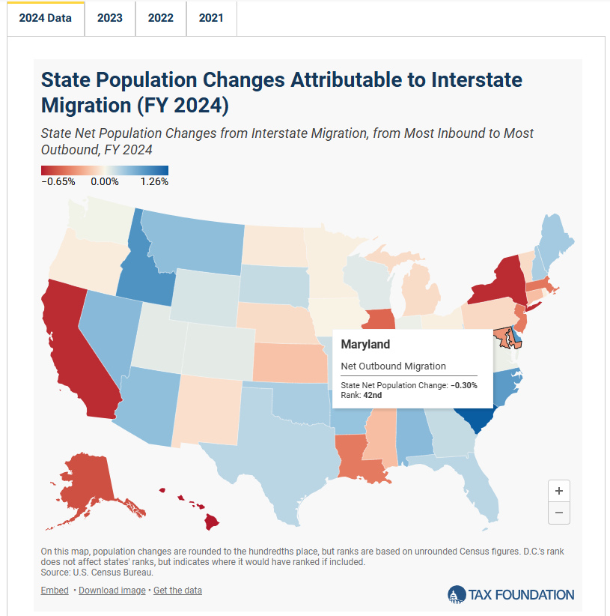
Maryland is one of the top 10 states for outbound migration (Rank: #42)
Delaware is one of the top 10 states for inbound migration (Rank: #3)
Pennsylvania: Rank #38
Virginia: Rank #26
Trend: Americans Moved to Lower-Tax States in 2024

Slide 11
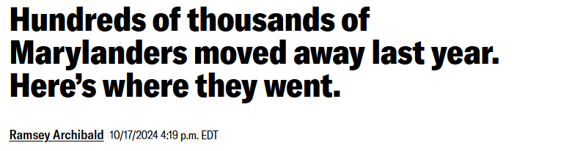
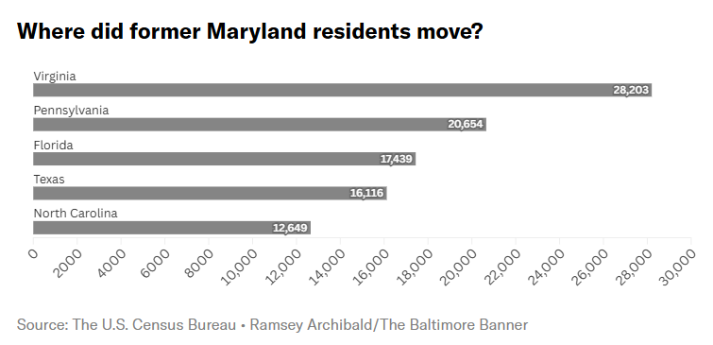
Roughly 200,000 people left Maryland for other states in 2023. (VA & PA most common destinations)
Maryland’s population would have shrunk if not for international migration,
Maryland lost about 20,000 residents to Texas and Florida, the two fastest growing states in the country.
The other most popular destinations were to Florida, Texas, California and North Carolina
Baltimore Banner
Notes:
https://www.thebaltimorebanner.com/community/local-news/moving-out-of-maryland-census-data-76ZWGRSMXNCKTGR62I4FONWZBA/

Slide 12
Population Growth
MD 34th for Growth Rate
45th for Total Migration
Metric | MD | VA | PA | DE | Best
Growth Rate from 2020 to 2023 (%) | 34th (0.27%) | 23rd | 41st | 7th | Growth rate since 2020: Idaho (7.63%)
Population Change from 2020 to 2023 (#) | 33rd | 14th | 47th | 19th | Texas
Total Migration from April 2020 to July 2023 | 45th -33,517 residents | 21st +43,207 residents | 26th +21,873 residents | 20th +44,124 residents | Florida +1,168,132 residents
Domestic from April 2020 to July 2023 | 44th -99,579 residents | 39th -37,414 residents | 40th -40,449 residents | 16th +38,468 residents | Florida +818,762 residents
International from April 2020 to July 2023 | 12th +66,062 residents | 9th +80,621 residents | 13th +62,322 residents | 44th +5,656 residents | Florida +349,370 residents
U.S. Census Bureau, 2023 ; Pew Charitable Trust, 2024; U.S. World News 2024

Slide 13
Highest Population Growths
2020–2023:
  Idaho, 7.63%
  South Carolina, 6.47%
  Florida, 6.41%
  Texas, 5.96%
  Delaware, 5.29%
2023:
  South Carolina, 1.7%
  Florida, 1.6%
  Texas, 1.6%
  Idaho, 1.33%
  North Carolina, 1.3%
  Delaware, 1.22%
U.S. Census Bureau; Pew Trusts

Slide 14
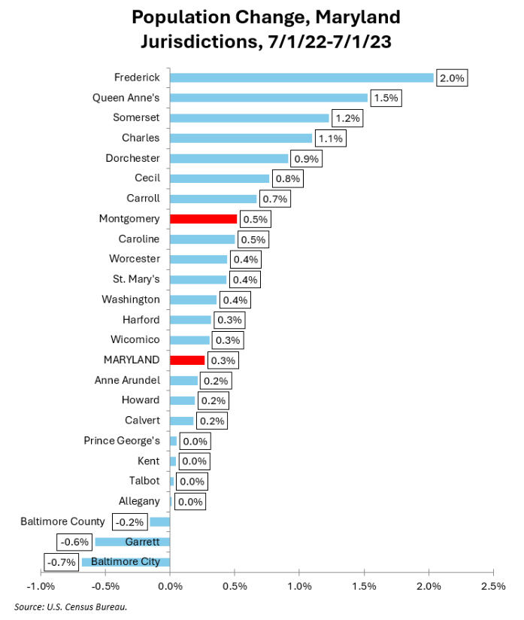
County Population Growth
2022-2023 Critical Trends
Frederick County: +2% growth
Queen Anne’s, Somerset, Charles – all above 1% growth
Cecil County: 0.8% growth
Prince George’s, Kent, Talbot & Allegany – all at 0% growth
Baltimore County, Garrett, Baltimore City – all loosing population
U.S. Census Bureau; Montgomery Perspective

Slide 15
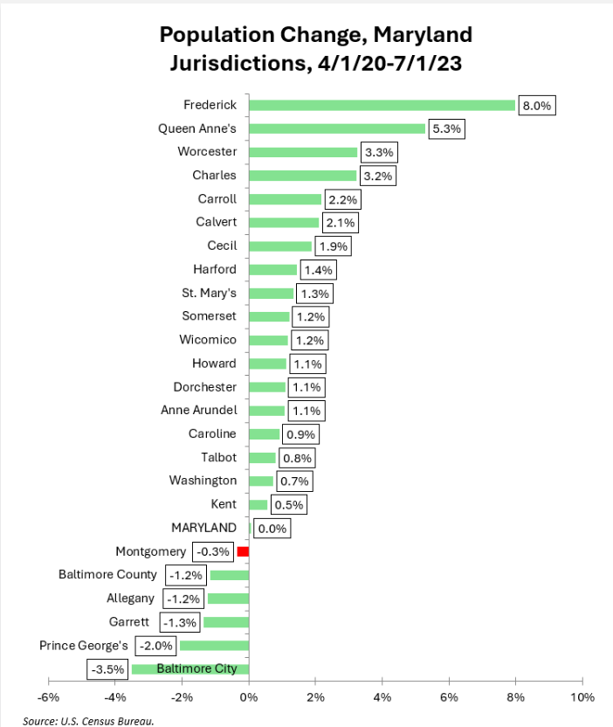
County Population Growth
2020-2023 Critical Trends
Frederick County: +8% growth (approx. 20K additional residents)
Cecil County: 1.9% growth
Montgomery, Baltimore County, Allegany, Garrett, and Prince George’s Counties all losing population
Baltimore City: -3.5% loss (approx. 20K residents)
U.S. Census Bureau; Montgomery Perspective

Slide 16
Business Tax Trends

Slide 17
State Business Tax Climate Index
The State Business Tax Climate Index evaluates how well states structure their tax systems, not just the total taxes collected; It helps compare tax systems by highlighting efficiency and competitiveness
States with simpler, lower tax rates — such as Indiana and Utah — often rank higher, while complex, high-rate systems contribute to lower rankings, as seen with Maryland
States with competitive tax systems are more successful in attracting businesses and fostering economic growth
While taxes are just one factor in business decisions, a clear and sensible tax structure can enhance business operations and improve investment appeal; Unlike other policy changes, tax reforms can boost a state’s business climate
States with lower tax costs are more attractive for investment, leading to greater economic development and job creation

Slide 18

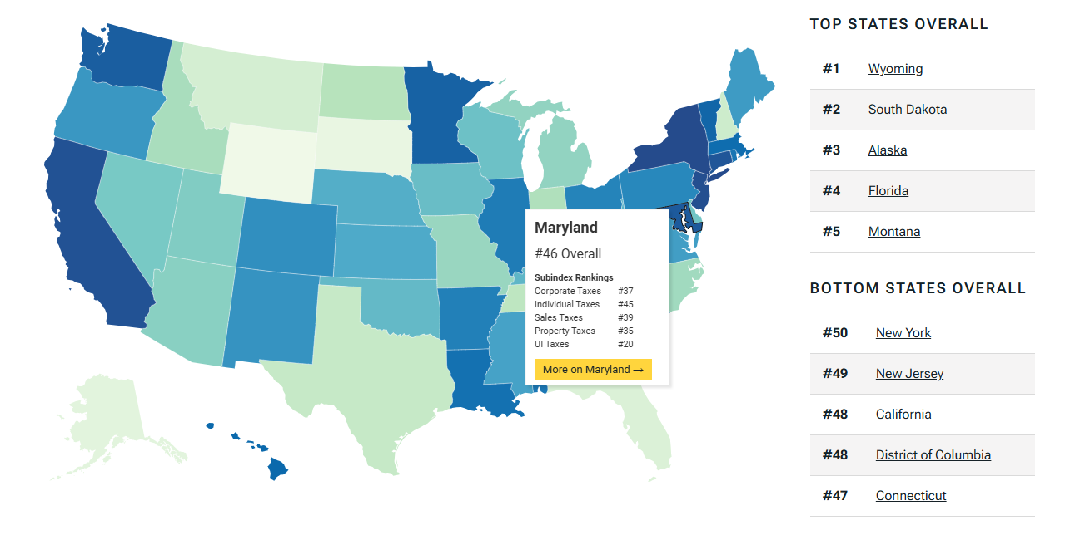
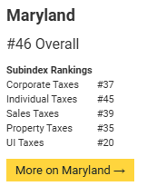
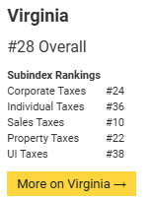
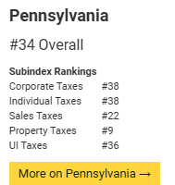
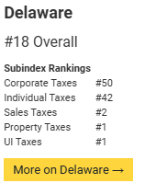
Maryland Ranks 46th for Tax Climate

Slide 19
State Business Tax Climate Index
MD 45th
overall
33rd in corporate tax
43rd in unemployment
insurance tax
Metric | MD ‘23 | MD ‘24 | MD ’25 | VA ‘25 | PA ‘25 | DE ‘25 | Best
Overall Business Tax Climate | 46 | 45 | 46 ↓ | 28 | 34 | 18 | Wyoming
Corporate Tax | 33 | 33 | 37 ↓ | 24 | 38 | 50 | Wyoming
Ind. Income Tax | 45 | 45 | 45 ╍ | 36 | 38 | 42 | Wyoming
Sales Tax | 30 | 34 | 39 ↓ | 10 | 22 | 2 | New Hampshire
Property Tax | 42 | 42 | 35 ↑ | 22 | 9 | 1 | New Mexico
Unemployment Ins. Tax | 41 | 43 | 20 ↑ | 38 | 36 | 1 | Delaware
Maryland lags significantly behind regional competitors, such as Virginia, Delaware and Pennsylvania, in overall business tax climate
Poor rankings in corporate tax, individual income tax, sales tax and unemployment taxes are of significant concern
Tax Foundation, 2024
Notes:
https://taxfoundation.org/research/all/state/2024-state-business-tax-climate-index/

Slide 20
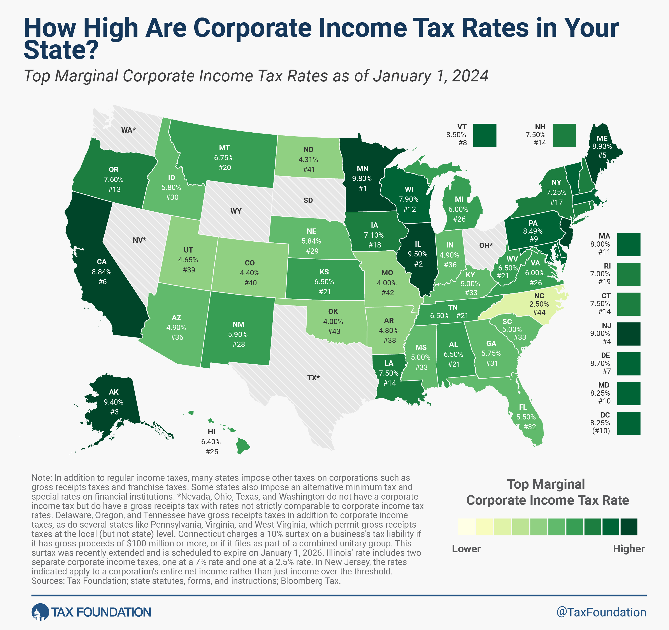
Corporate Tax Rates
Maryland: 8.25% (10th highest)
Virginia:
6% (#26)
Pennsylvania: 8.49% (#9)
Delaware: 8.7% (#7)

Slide 21
Corporate Tax Rates: National Comparison
Highest Corporate Rates
Minnesota: 9.8%
Illinois: 9.5%
Alaska: 9.4%
New Jersey: 9.0%
Maine: 8.93%
California: 8.84%
Delaware: 8.70%
Vermont: 8.5%
Pennsylvania: 8.49%
Maryland: 8.25%
(Tied w/ D.C.)
Competitive Rates (≤5%)
Colorado: 4.4%
Utah: 4.85%
Arizona, Indiana: 4.9%
Kentucky, Mississippi, S.C.: 5%
Lowest Corporate Rates
North Carolina: 2.5%
Missouri, Oklahoma: 4.0%
North Dakota: 4.31%
Tax Foundation, 2024

Slide 22
Corporate Tax Rates: National Comparison
Notable Corporate Tax Changes
New Jersey – Reduced from 11.5% to 9.5%
Arkansas – Reduced from 5.1% to 4.8%
Iowa – Reduced from 8.4% to 7.1%
Pennsylvania, Kansas and Nebraska – also implementing pro-growth tax reforms
Tax Foundation, 2024

Slide 23
Business & Job Growth Trends

Slide 24
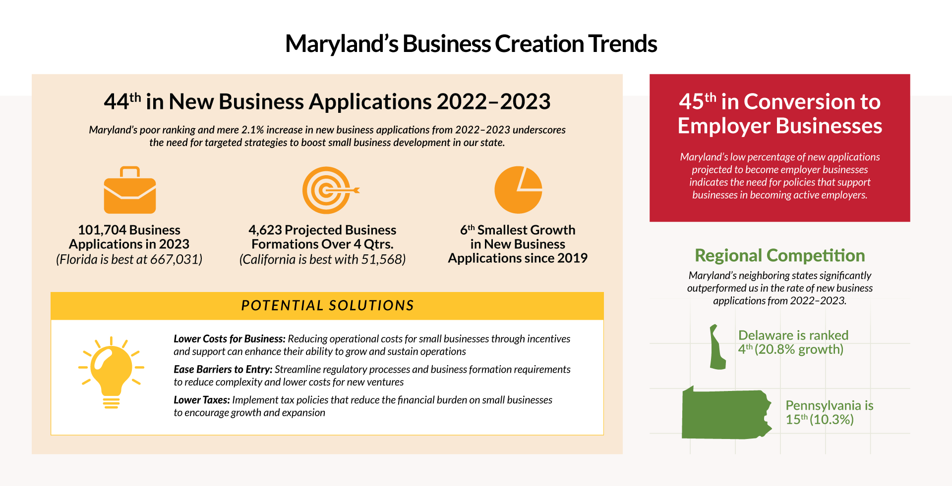

Slide 25
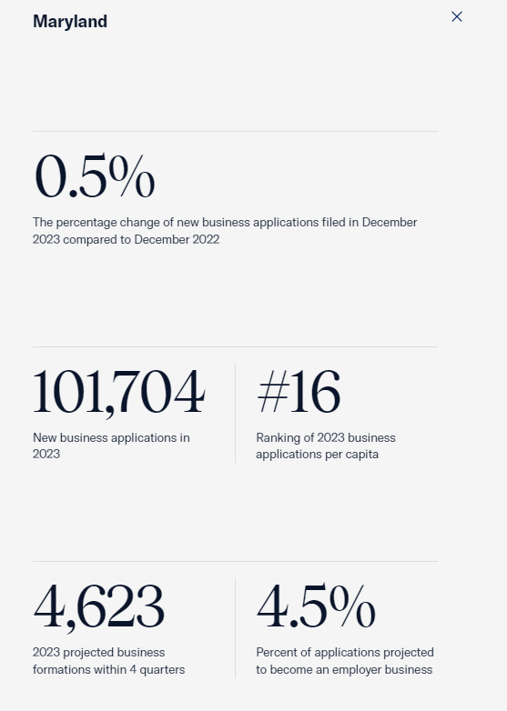
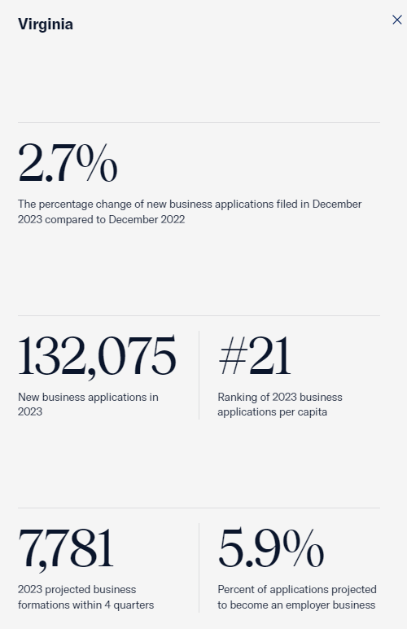
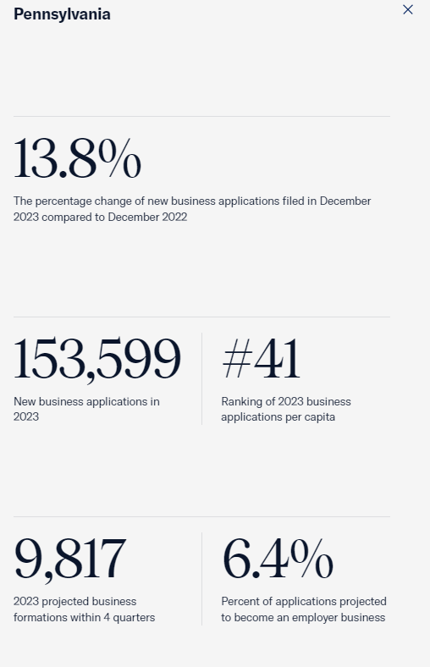
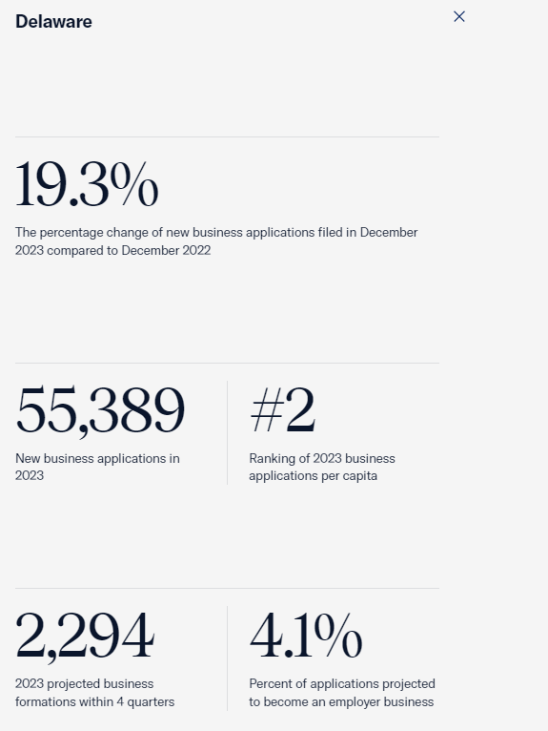
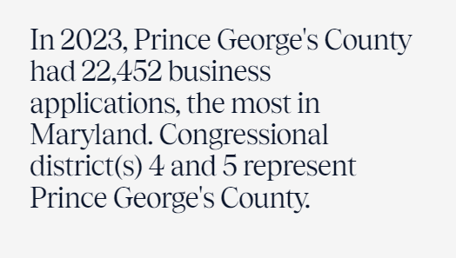
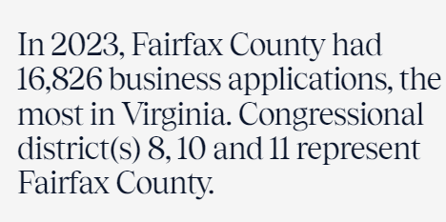
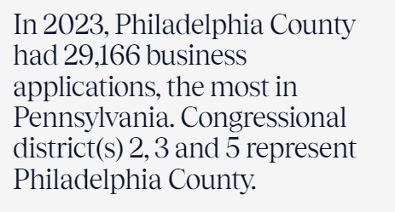
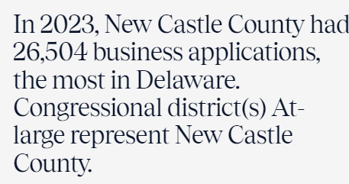
MD
New Business Applications (December 2023 vs. 2022)
Maryland Ranks 44th in New Business Applications from 2022-2023
VA
PA
DE
U.S. Chamber of Commerce, 2024
Notes:
Maryland’s Numbers:
0.5% The percentage change of new business applications filed in December 2023 compared to December 2022
101,704 New business applications in 2023
#16 Ranking of 2023 business applications per capita
4,623 2023 projected business formations within 4 quarters
4.5% Percent of applications projected to become an employer business
In 2023, Prince George's County had 22,452 business applications, the most in Maryland. Congressional district(s) 4 and 5 represent Prince George's County.

Slide 26
Non-Agricultural Employment
(September 23-September 24)
MD 28th
overall
41st in percent job growth
Metric | MD ‘21-’22 | MD ‘22-’23 | MD 23-24 | VA ’23-24 | PA ’23-24 | DE ’23-24 | Best
Non-Agricultural Employment Growth: Jobs Added | 22 68,800 jobs added | 37 ↓ 16,200 jobs added | 28 ↑ 24,800 jobs added | 10th; 68,500 jobs added | 5th; 100,900 jobs added | 46th ; 4500 jobs added | Texas; 310,400 jobs added
Non-Agricultural Employment Growth: % Growth | 34 % growth = 2.6% | 49 ↓ % growth = 0.6% | 41 ↑ % growth = 0.9% | 19th % growth 1.6% | 17 % growth 1.6% | 39 % growth 0.9% | Montana; 3.3% growth
3-Year Compound Growth Rate (July ‘24) |  |  | 48th | 12th | 32nd | 19th | Nebraska
Labor Force Participation Rates (July ’24) |  |  | 13th 65.5% | 9th 66.1% | 28 62.9% | 39 59.7% | North Dakota, 68.9%
U.S. Bureau of Labor Statistics, July 2024; Sept 2024; Federal Reserve Bank, 2024; U.S. News, 2024
Notes:
The labor force participation rate (LFP rate) is the percentage of the civilian noninstitutional population that is either working or actively looking for work.
https://i95business.com/articles/content/labor-shortages-pose-dire-problem-for-marylands-economy-2274

Slide 27
Non-Agricultural Employment
(2014-2024)
MD 30th
overall
39th in percent job growth
Metric | MD 13-23 | MD 13-23 | VA ’13-23 | PA ’13-23 | DE ’13-23 | Best
Non-Agricultural Employment Growth: Jobs Added | 28th 155,000 jobs added | 30 ↓ 139,000 jobs added | 11th; 451,800 jobs added | 15th; 398,900 jobs added | 38th; 50,800 jobs added | Texas; 2,601,400 jobs added
Non-Agricultural Employment Growth: % Growth | 34th 6.0% growth | 39↓ % growth 5.3% | 18th % growth 11.9% | 34th % growth 6.8% | 19th ; % growth 11.5% | Idaho 33.3% growth
U.S. Bureau of Labor Statistics

Slide 28
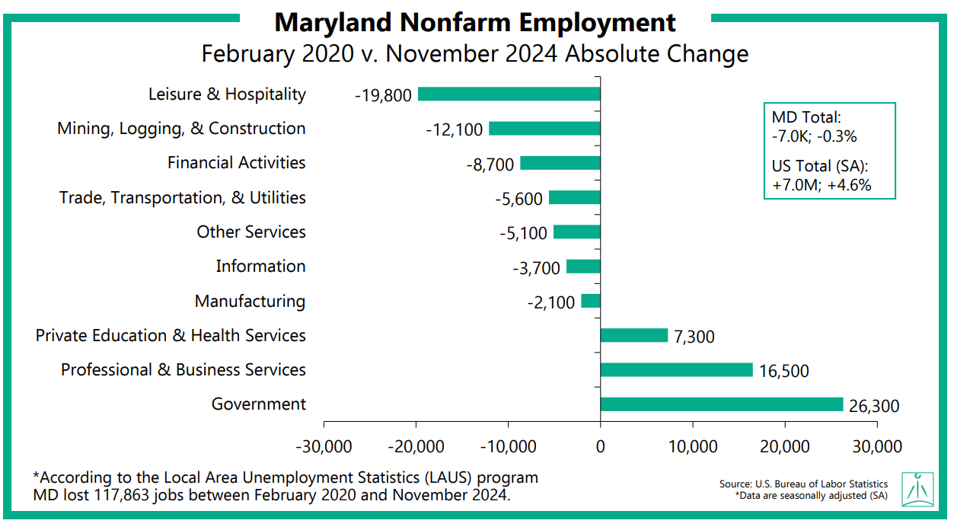
Maryland lost 117,863 jobs between February 2020 and November 2024
Courtesy of presentation by Anirban Basu, Sage Policy

Slide 29
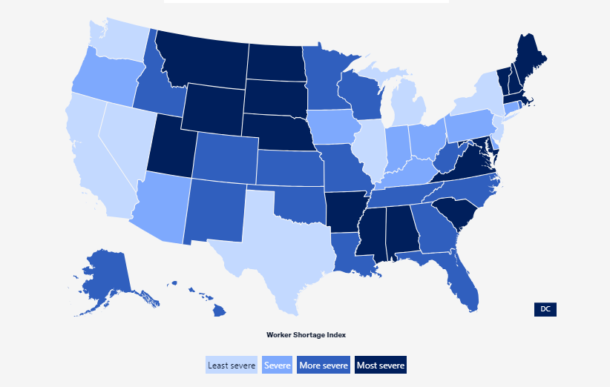
The Worker Shortage Across America (September 2023)
Maryland's Worker Shortage Index: 0.33
Maryland has 33 available workers for every 100 open jobs
Job Openings: 165,000
Unemployed Workers: 54,778
Labor Force Participation Rate: 65.3
U.S. Census Bureau; Pew Trusts

Slide 30
Transportation & Infrastructure

Slide 31
The Critical Role of Transporation
Why it Matters:
Economic Growth: Reliable transportation systems enhance business operations and access to markets
Quality of Life: Efficient transport reduces commute times and improves overall living standards
Competitiveness: Well-developed infrastructure attracts businesses and supports economic development

Slide 32
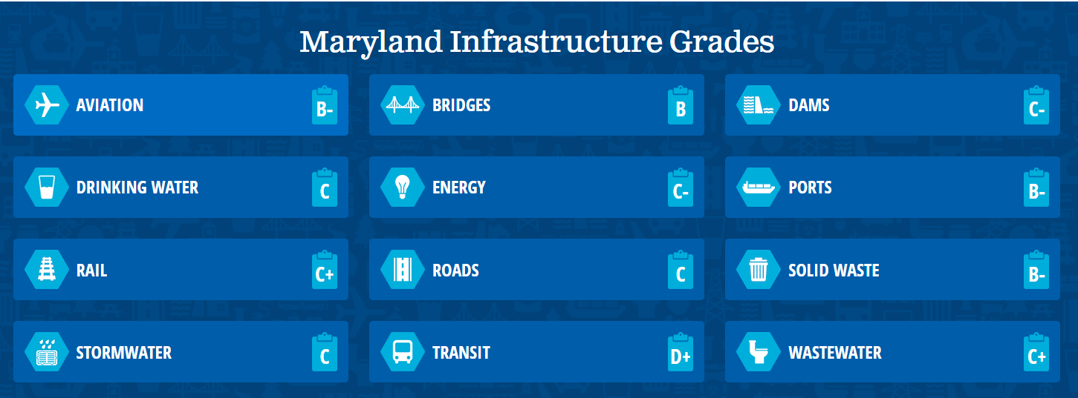
Maryland's Infrastructure Report Card
2020 Report Card for America’s Infrastructure, American Society of Civil Engineers
Notes:
https://infrastructurereportcard.org/state-item/maryland/

Slide 33
State Roadway Expenditures, ‘21
MD 37th
in road spend
26th road maintenance spend, p.c.
38th in capital, per capita
Metric | MD ‘20 | MD ‘21 | VA ‘21 | PA ‘21 | DE ‘21 | Best
Total Revenue State + Local | $78,310,789 | $101,680,189 | $135,480,993 | $209,709,429 | $20,239,971
Expenditures State + Local | $81,013,527 | $84,783,324 | $104,653,764 | $176,924,751 | $14,478,840
Total per capita road spending | 37th $285 | 38th ↓ $291 | 17th $461 | 26th $436 | 2nd $1,104 | Alaska ($1,253)
Capital per capita | 30th $271 | 39th ↓ $210 | 35th $222 | 33rd $250 | 6th $497 | Alaska ($956); More than 3x Maryland’s spend
Per capita road maintenance spending | 48th $14 | 27th ↑ $81 | 5th $222 | 11th $139 | 1st $607 | Delaware ($607); More than 7x Maryland’s spend
Percentage of Acceptable Miles |  | 45th 70.29% | 29th 82.26% | 42nd 73.82% | 26th 83.74% | Alabama; U.S. Percentage was 81.70%
U.S. Department of Transportation, 2021; Bureau of Transportation Statistics.
Notes:
Revenue, Expenditures Data: https://www.bts.gov/browse-statistical-products-and-data/state-transportation-statistics/state-and-local-government
2021 is the latest year data is available for.
Spending: Redbook
Road Condition: https://www.bts.gov/road-condition and https://www.usnews.com/news/best-states/rankings/infrastructure/transportation/road-quality
Maryland had 32,572 miles of public road as of 2022; 722 miles of freight railroad; 5,456 bridges; of states we’re comparing ourselves to, only Delaware has less miles of road, railroad and bridges.
https://www.bts.gov/state-transportation-infrastructure
https://reason.org/policy-study/26th-annual-highway-report/
https://infrastructurereportcard.org/state-by-state-infrastructure/

Slide 34
Commute Times
MD 3rd
longest commutes
Metric | MD ‘21 | MD ‘22 | MD ‘23 | VA ‘23 | PA ‘23 | DE ‘23 | Best
Avg. commute time: D.C. Metro | D.C. Metro: 2nd longest 31.9 min Balt. Metro: 17th longest, 27.6 min | D.C. Metro: 3rd longest ↑ 32.3 min Balt. Metro: 12th longest ↓ 29.0 min | D.C. Metro: 3rd longest -- 32.7 min Balt. Metro: 10th longest ↓ 29.7 min | D.C. Metro: 3rd longest, 32.3 min | Phila. Metro: 13th longest, 29.3 min Pittsburgh Metro: 31st longest, 25.9 min | Phila. Metro: 13th longest, 29.3 min | Buffalo-Cheektowaga, NY 21.8 minute commute; D.C. Metro is 48% longer
According to U.S. News, Maryland is ranked 49th in for commute time
Commute times worsened in 2023 across Maryland's major metro areas of Baltimore and Washington, D.C. (Data is from pre-bridge collapse.)
Long, unreliable commutes in major metro areas lower worker productivity, hinder attraction of talent and make access to jobs difficult for workers lacking transport options
U.S. Census, 2022
Notes:
https://www.usnews.com/news/best-states/rankings/infrastructure/transportation/commute-time

Slide 35
Energy Costs

Slide 36
Energy Costs
Maryland ranks 39th in energy costs for industrial customers, 37th for commercial, 35th for retail
Metric | MD ‘22 | MD ‘23 | VA ‘23 | PA ‘23 | DE ‘23 | Best
Average Retail Price per KwH for Industrial Customers | 40th 10.01 cents/KwH | 39th 9.94 cents/KwH (- 0.07 from 2022) | 36th 8.92 cents/KwH (+0.93) | 25th 7.75 cents/KwH (-0.46) | 27th 7.85 cents/KwH (-0.94) | New Mexico, 5.75 cents/KwH (-0.81)
Average Retail Price per KwH for Commercial Customers | 37th 12.65 cents/KwH | 37th 12.77 cents/KwH (+0.12 from 2022) | 7th 8.95 cents/KwH (-0.71) | 24th 11.26/KwH (+0.53) | 29th 11.83/KwH (+0.85) | North Dakota 7.38 cents/KwH (-1.07)
Average Retail Price per KwH for Retail Customers | 34th 14.46 cents/KwH | 35th 16.60 cents/KwH (+2.14 from 2022) | 25th 14.46 cents/KwH (+0.92) | 39th 18.10 cents/KwH (+2.16) | 34th 15.73 cents/KwH (+2.02) | Washington 10.98 cents/KwH (+0.72)
In 2023, Maryland generated 4.7% of energy from coal, ranking 34th in the nation, and dropping from 12.5% in 2022. The state generated 42.6% of its energy from natural gas, 41.6% from nuclear sources, 10.0% from renewable resources, 0.2% from petroleum and 0.9% from pumped storage and other sources.
U.S. Department of Energy, 2022 and 2023

Slide 37
GDP Data

Slide 38
Gross Domestic Product (2023)
Maryland ranks 18th in total GDP; 29th for percentage change from 2022 to 2023
Metric | MD ‘22 | MD ‘23 | VA ‘23 | PA ‘23 | DE ‘23 | Best
Total GDP | 15th ^{$438,235} | 18th $515,607 million | 13th $719,897 million | 6th $976,361 million | 42nd $98,069 million | California
% Change, 2022-2023 | 49th 6.7% | 29th 6.3% | 8th 8.0% | 32nd 6.2% | 35th 6.0% | Florida, 9.2%
U.S. Department of Commerce, 2023

Slide 39
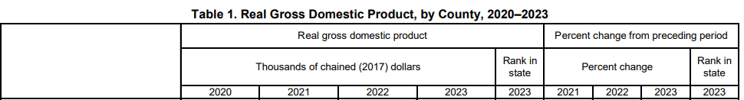
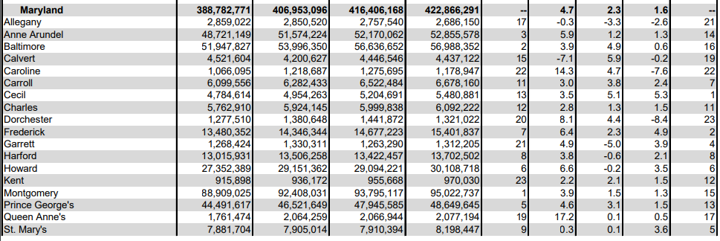
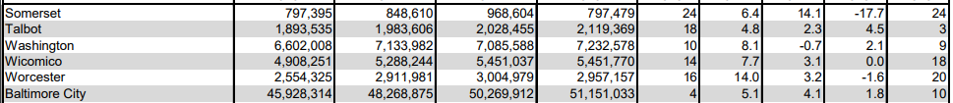
Gross Domestic Product (2023)
Cecil County
Total GPD: Ranked #13
Percentage Change: Ranked #1
U.S. Department of Commerce, 2023

Slide 40
Overall Economic Performance and Economic Outlook

Slide 41
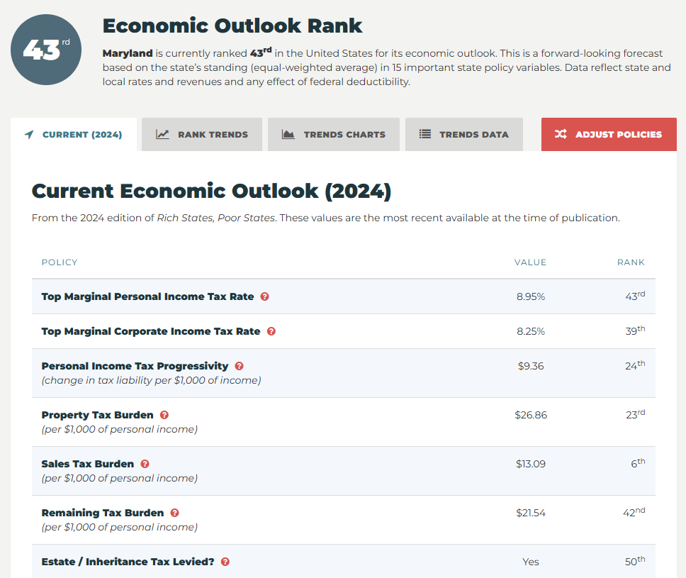
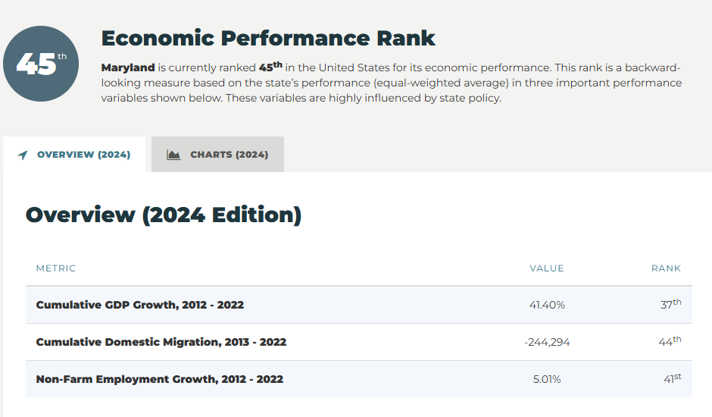
Rich States, Poor States 2024

Slide 43
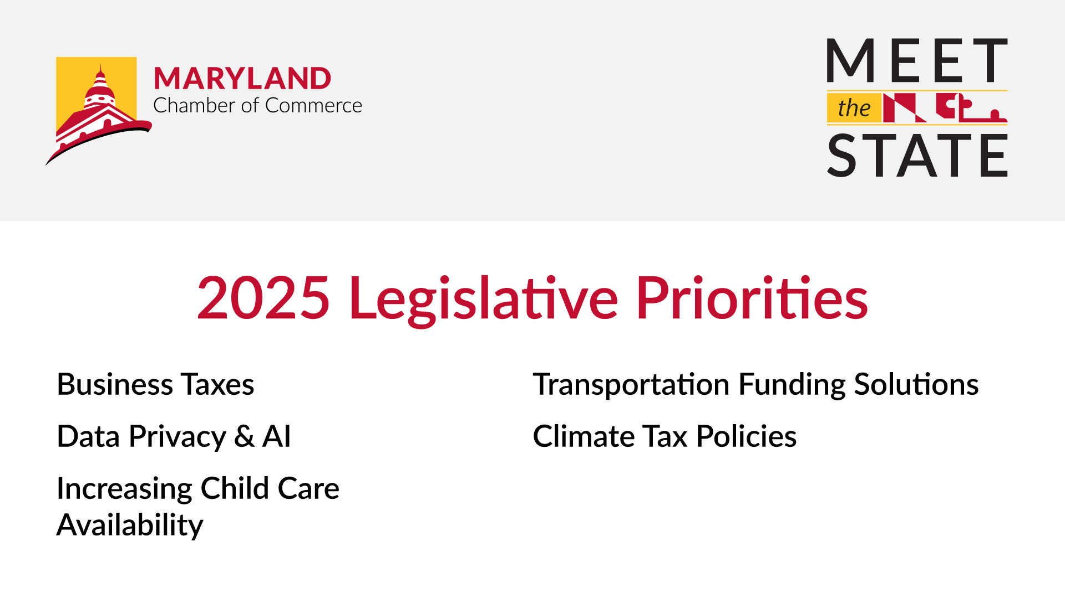

Slide 44


