Slide 1

CECIL County ENTERPRISE ZONE
EDC Meeting
March 5, 2025
EVIDENCE BASED FACTS

Slide 2

WHAT IS AN ENTERPRISE ZONE?
enterprise zone
[ˈen(t)ərˌprīz ˌzōn]
NOUN
An economically depressed area in which business growth
is encouraged by the government through tax relief and financial concessions.

Slide 3
Maryland’s Enterprise Zone Program
  Established in 1982
  Objective is to encourage economic growth in economically distressed areas and boost the employment of the chronically unemployed
  Gives local governments the legal authority to offer real property and state income tax credits to qualified businesses
  If any portion of a proposed Enterprise Zone is within a municipality, the governing body of the municipality must consent to the inclusion of the area within its jurisdiction
  Designations are for a 10-year period. Re-designation of all or a portion of the designated zone must occur before the end of the10-year designation period*
  Currently 36 Enterprise Zones in the state
  *Cecil County’s Enterprise Zone was re-designated on June 14, 2023, which means the 10-year designation period expires on June 14, 2033, unless the proposed sunsetting of the program occurs on June 30, 2025. Should the program sunset as proposed, all properties currently certified will receive property tax credits until their respective 10-year period expires.

Slide 4
Qualifying criteria for The Establishment of an Enterprise Zone
  Is in a Priority Funding Area
  Meets at least one of the following unemployment rate, poverty level, median family income level, or population benchmarks:
    Area has at least 150% of the greater of the average rate of unemployment in either the State or the U.S.;
    The population in the area qualifies as a low–income poverty area;
    At least 70% of the families in the area have incomes that are less than 80% of the median family income in the area; or
    The population in the area decreased by 10% between the most recent two censuses, and can demonstrate that chronic abandonment or demolition of property is occurring in the area or substantial property tax arrearages exist in the area.

Slide 5
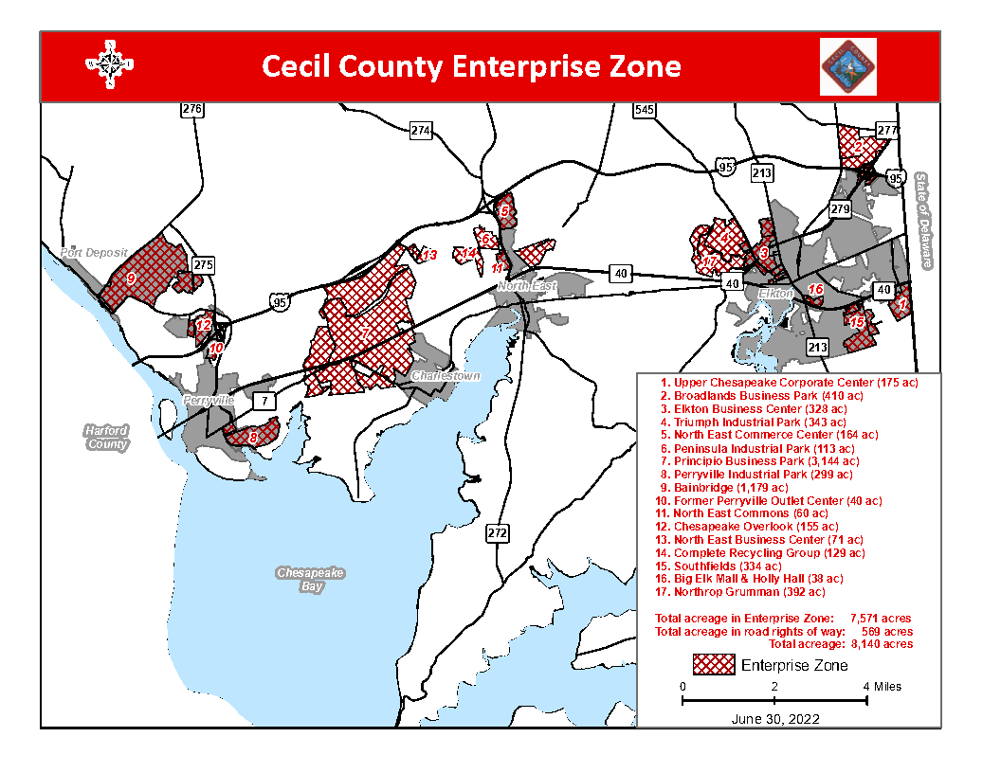

Slide 6
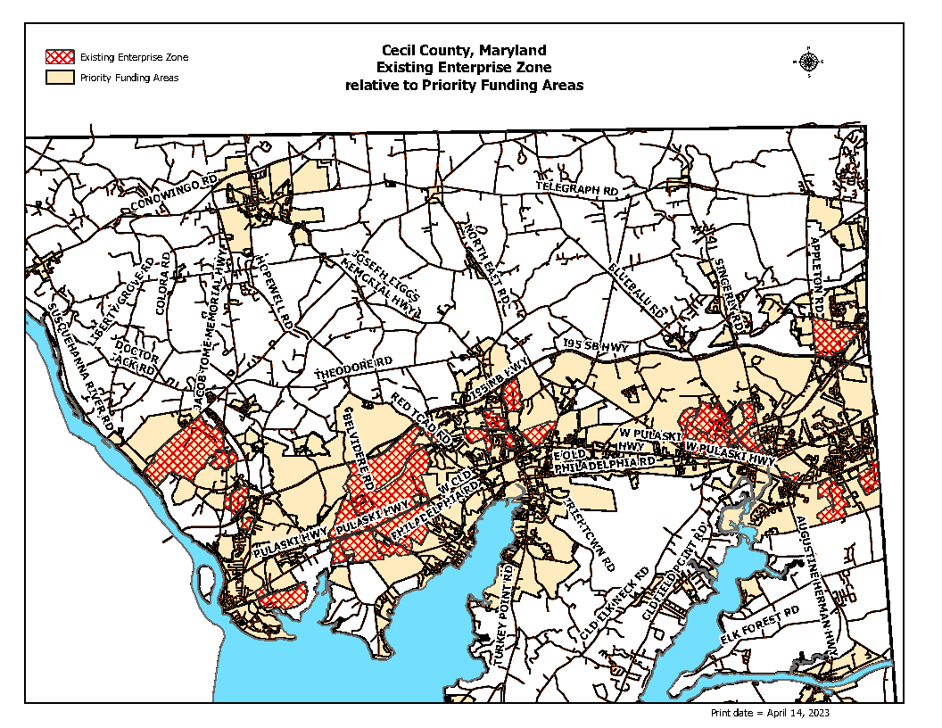

Slide 7
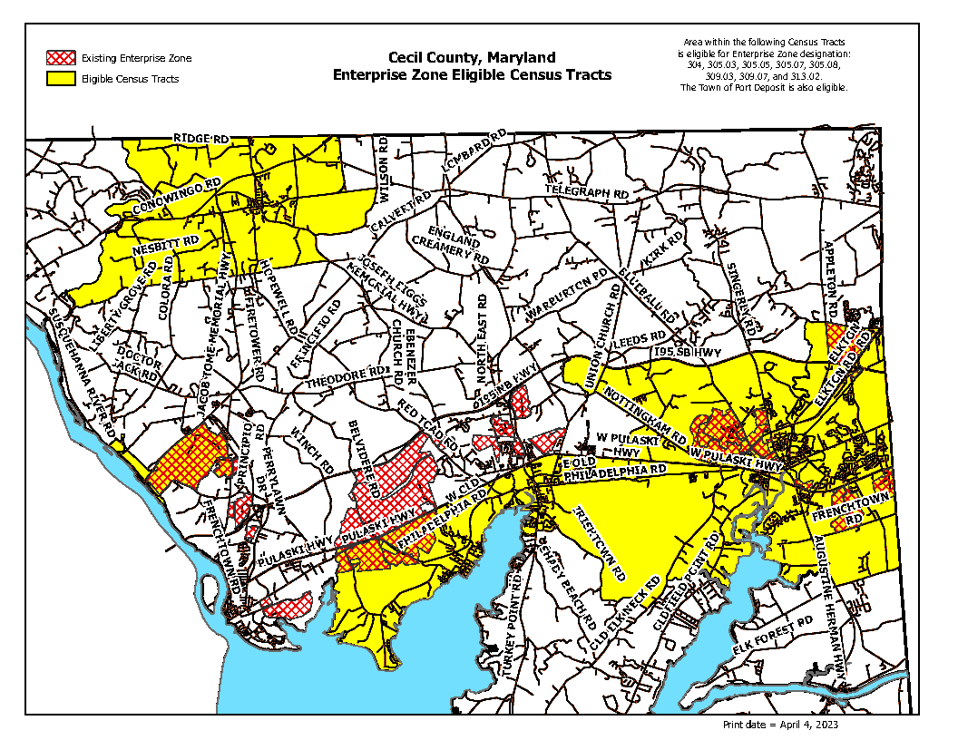
Qualified Census Tracts at time of EZ Redesignation in June 2023.

Slide 8
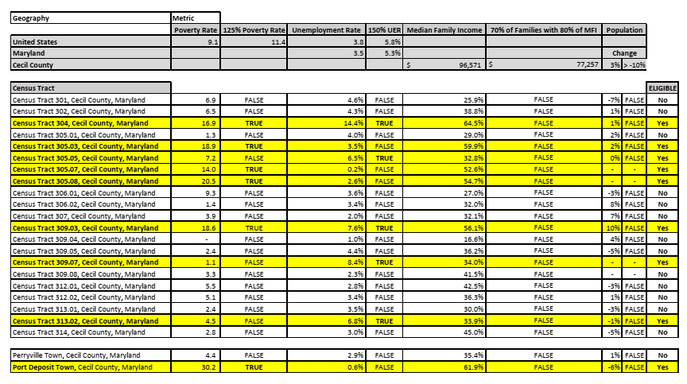

Cecil’s Qualifying census tracts*
*Yellow highlighting indicates census tracts and towns meeting one of the four economic indicators required for Enterprise Zone designation (see slide 4) at time of Cecil’s EZ Redesignation in June 2023.

Slide 9
Cecil’s enterprise zone standards
To be eligible for Enterprise Zone incentives in Cecil County, a business entity must:
  Locate or expand within the boundaries of the Cecil County Enterprise Zone;
  Engage in a business activity that is industrial or commercial in nature;
  Be in good standing with Cecil County and the State of Maryland; and
  Hire one or more new full-time employee(s) (works a minimum of 35 hours per week) in order to take advantage of the income tax credit. (Jobs must be new to State)
Changes to the Cecil County Enterprise Zone standards must be approved by the County Council and the Secretary of Commerce.

Slide 10
Enterprise zone Income tax incentives
There are two types of Enterprise Zone income tax credits for qualified businesses with qualified employees – a General Income Tax Credit (a one-time $1,000 state income tax credit) and an Income Tax Credit for Economically Disadvantaged Employees (a $6,000 state income tax credit over three years).
These income tax credits can be stacked with other job creation-based income tax credits, such as the Job Creation Tax Credit (JCTC), which is being terminated as part of The DECADE Act.
There is no credit on the County’s portion of the income tax!

Slide 11
Enterprise zone Real Property Tax incentive
  A 10-year credit against local property taxes (county and municipal, if in a town) is available to companies that locate, expand, or substantially improve business properties in the Enterprise Zone.
  The Property Tax Credit is on the increased assessed value of the expansion, renovation, or capital improvement as determined by the Maryland Department of Assessments & Taxation.
  The amount of the annual credit is 80% of the "eligible assessment" in each of the first 5 years after which the credit decreases 10% annually for each of the subsequent 5 years.
  The State pays 50% of the tax credit back to local jurisdictions for each year of the 10-year period. (From the Maryland Code, Real Property § 9-103: As provided in the State budget, the State shall remit to each county or municipal corporation an amount equal to one-half of the funds that would have been collected if the property tax credit under this section had not been granted.)
Year | % of Credit on Eligible Assessment | % of Tax on Eligible Assessment Received by County | % of Tax on Eligible Assessment State Reimburses the County (equal to 50% of the property tax credit a business receives in a given year) | Total % of Eligible Assessment County Receives*
1 | 80 | 20 | 40 | 60
2 | 80 | 20 | 40 | 60
3 | 80 | 20 | 40 | 60
4 | 80 | 20 | 40 | 60
5 | 80 | 20 | 40 | 60
6 | 70 | 30 | 35 | 65
7 | 60 | 40 | 30 | 70
8 | 50 | 50 | 25 | 75
9 | 40 | 60 | 20 | 80
10 | 30 | 70 | 15 | 85
* Total revenue the County receives over 10 years is 67.5% (total of last column above divided by 10) of what would have been owed if there was no EZ.

Slide 12
ExAmple of Property Tax Revenue received Over A 10-Year Period
For illustrative purposes only: In 2022 Blue Enterprises bought an unimproved 20-acre parcel in the EZ and in 2023 completed the construction of a new industrial building on the site. The unimproved land was assessed at $5 million, and the new building assessed at $75 million, which is considered the ‘eligible assessment’ on which the Enterprise Zone property tax credit is applied. Figures based on 2023 property tax rates.
Parcel remains unimproved: $513,950
Parcel developed within EZ and receives a property tax credit: $5.7 million
Parcel developed without EZ so no property tax credit received: $8.2 million
  Remember, the State currently reimburses local jurisdictions 50% of the property tax credit each year of the 10-year period.
Assumes the property will be developed w/out the EZ designation!
In this example there is only a $2.5 million difference in revenue to the county by having the EZ and not having it, while there in a $5.2 million difference between no development and development within the EZ.
Without EZ incentives, industrial development is highly unlikely as developers/businesses will ask for other financial enticements, and if not received, they will go elsewhere.
The EZ is undeniably Cecil County’s most effective attraction and expansion tool, making it vital to driving sustained economic growth.

Slide 13
FY2014 – FY2024 Property tax revenue RECEIVED FROM CERTIFIED enterprise zone PROPERTIES
TAX YEAR | ELIGIBLE ASSESSMENT | TAX CREDIT AMOUNT | REIMBURSEMENT FROM STATE | AMOUNT TAX COUNTY COLLECTED | TOTAL COUNTY TAX COLLECTED + REIMBURSEMENT
2024 | 654,153,706 | $ 6,426,406.01 | $ 3,213,203.00 | $ 3,551,336.31 | $ 6,764,539.31
2023 | 673,070,429 | $ 6,679,550.94 | $ 3,339,775.47 | $ 3,008,297.55 | $ 6,348,073.02
2022 | 412,788,609 | $ 4,186,914.86 | $ 2,093,457.43 | $ 2,691,295.20 | $ 4,784,752.63
2021 | 364,306,276 | $ 3,744,704.21 | $ 1,872,352.11 | $ 2,105,824.70 | $ 3,978,176.80
2020 | 297,079,310 | $ 3,093,783.93 | $ 1,546,891.97 | $ 1,721,160.55 | $ 3,268,052.52
2019 | 290,653,715 | $ 3,026,867.79 | $ 1,513,433.89 | $ 1,612,999.31 | $ 3,126,433.20
2018 | 162,446,230 | $ 1,691,715.04 | $ 845,857.52 | $ 989,497.70 | $ 1,835,355.22
2017 | 96,607,754 | $ 757,984.18 | $ 378,992.09 | $ 6,427,078.41 | $ 6,806,070.50
2016 | 51,601,917 | $ 511,581.41 | $ 255,790.70 | $ 724,557.57 | $ 980,348.27
2015 | 59,214,116 | $ 586,634.25 | $ 293,317.12 | $ 826,538.87 | $ 1,119,855.99
2014 | 74,968,769 | $ 742,715.59 | $ 371,357.80 | $ 1,689,565.51 | $ 2,060,923.31
 |  |  |  | TOTAL FY2014 – FY2024 | $ 41,072,580.78

Slide 14
TAXES & fees paid by 6 of the Most recently constructed & Occupied Large Facilities Within the cecil County enterprise zone
Company | Real Property Tax* | Personal Property Tax | Permitting Fees | Recordation Tax & Transfer Fees | Utility Tax | TOTAL
Amazon | 3,196,196.45 | 7,065,319.88 | 703,122 | 2,337,580 | 237,000.48 | 13,539,218.81
Lidl | 2,857,858.22 | 1,089,581.52 | 314,286 | 560,967 | 278,429.94 | 5,101,122.68
Smithfield | 1,793,719.09 | 952,293.35 | 190,023 | 1,102,200 | 398,651.42 | 4,436,886.86
Medline | 1,725,487.51 | 1,659,901.18 | 362,832 | 211,200 | 81,866.16 | 4,041,286.85
KeHE | 1,565,787.49 | 780,021.28 | 208,820 | 1,364,852 | 160,947.92 | 4,080,428.69
Great Wolf Lodge | 966,548.49 | 811,868.42 | 242,493 | 58,872 |  | 2,079,781.91
TOTAL | 12,105,597.25 | 12,358,985.63 | 2,021,576 | 5,635,671 | 1,156,895.92 | 33,278,725.8
Includes all taxes & fees paid from construction to date.
*Currently this column is solely the amount reimbursed from the State and does not include the real property tax paid by the companies to the County. The Finance Department should have the actual tax paid numbers to us soon, which will show the complete picture. This slide will be update accordingly upon receipt of those numbers.

Slide 15
Cecil county Enterprise zone 2018 - 2024
Over 5,000 new jobs created
Over $1.5 billion in capital investments
Over 10 million new square feet

Slide 16
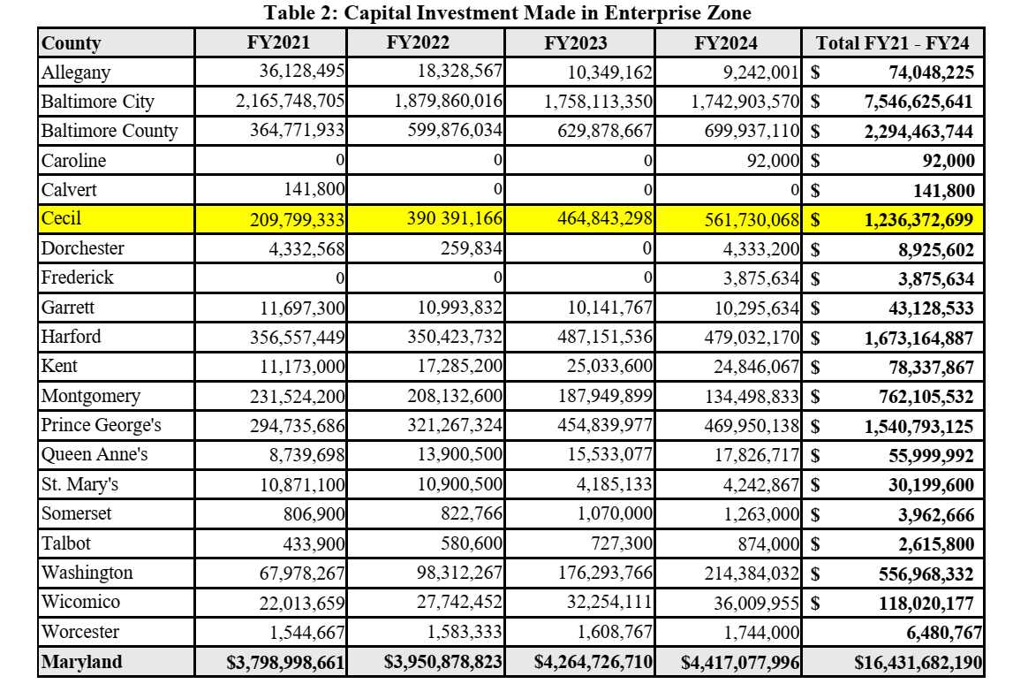
Capital Investments Made Statewide in Enterprise zones FY2021 – FY2024
The top five largest amounts of capital investments in a jurisdiction were Baltimore City, Baltimore, Cecil, Harford, and Prince George’s Counties.
Among jurisdictions that have had the largest percentage increase in investment dollars over the four-year period are Baltimore City, Cecil, Harford, Prince George’s, and Montgomery Counties.

Slide 17
Potential Projects in the enterprise zone within the next 5 years
Bainbridge Phase I - up to 3,750,000
• Lot B: 1,026,000 SF construction completed
• Lot C: 605,280 SF construction completed
• 1,739,400 SF – developer in final negotiations w/prospect
• 378,000 SF proposed
Bainbridge Phase II
• AquaCon (announced): $320 MM CAPEX, 300 new jobs to be created
• Developer in negotiations on other locations within Phase II
Elkton Commerce Center
• Coming 2026 – 330,288 SF
• 2 future buildings of 1,096,200 SF and 924,000 SF
Principio Business Park – several sites proposed
North East Commerce Center – A. Duie Pyle constructing approx. 50,000 SF building, # of new jobs to be created unknown at this time
Northrop Grumman is planning more expansions within the next 5 years, including a new engineering & administration building starting this year, a case prep facility, a conditioning building, and an AP storage facility

Slide 18
Why Support the Enterprise Zone?
Our ability to attract new businesses would be severely compromised without the Enterprise Zone. While we have a prime location along I-95 in the middle of two major markets, it is the incentives package (mainly the EZ) we can offer, along with continued infrastructure improvements, that allows us to take advantage of our location when negotiating with prospects.
If Cecil County did not participate in the Enterprise Zone program, the tax contributions made by Cecil County taxpayers that support the program would go elsewhere in the state.
If Enterprise Zone incentives are not offered, companies will ask for other enticements. It’s a fact, incentives are part of the art of the deal in site selection everywhere, and Enterprise Zone incentives are one of the most cost effective.
New projects that move the needle in most cases will not happen anywhere without incentives!

